Slide 1
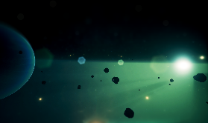
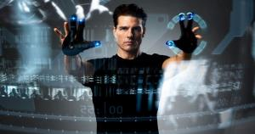
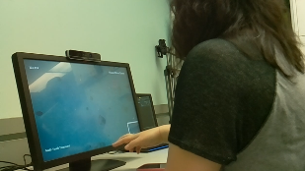
Gesture User Interfaces: Towards the Invisible Computer!
Francisco R. Ortega, Ph.D.
Assistant Professor
Director of NUI Lab
Computer Science
Colorado State University
Presentation at
Colorado State University
9/10/2018
Freshmen Seminar

Slide 2
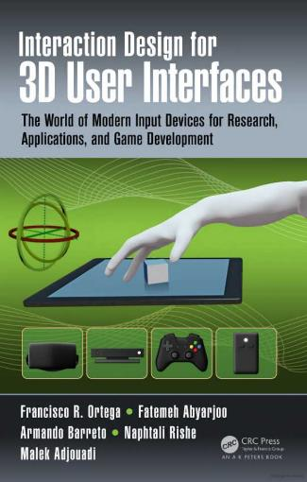
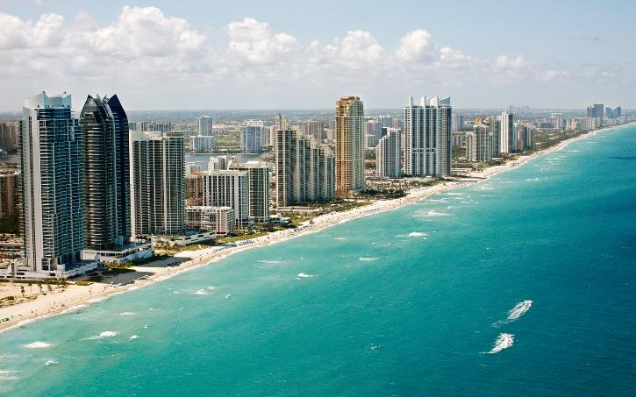
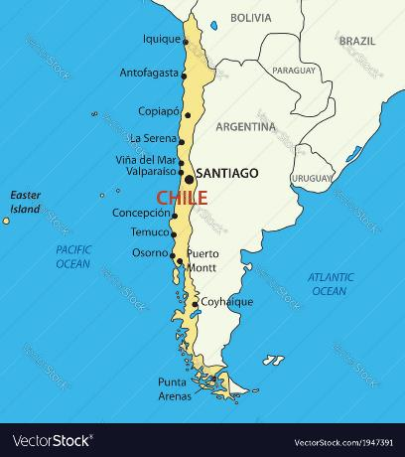
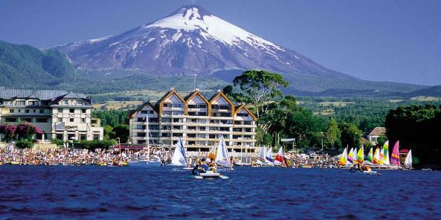
About Me
Born in Chile. Been living in Miami since 14 years of age
Graduated from Florida International University
Ph.D., M.S., B.S. in Computer Science
Published several publications and one book
Committed to Research, Teaching, and Service

Slide 3
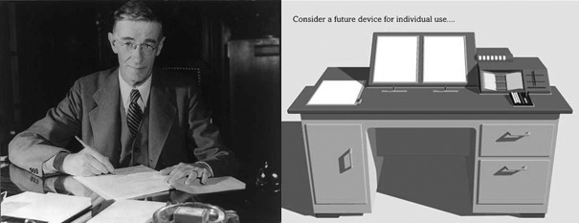
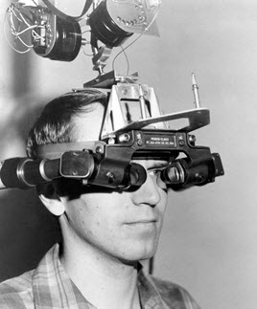
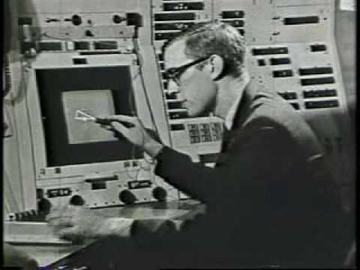
HCC
Human-Centered Computing
\
Vannevar Bush
“As We May Think” 1945
Ivan Sutherland
Head Mounted Display
1967
Ivan Sutherland
Sketchpad 1962

Slide 4
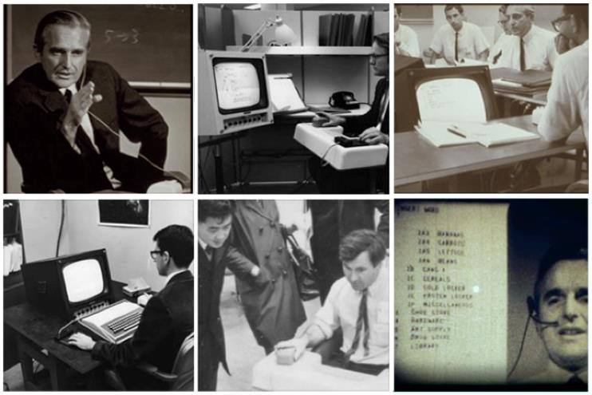
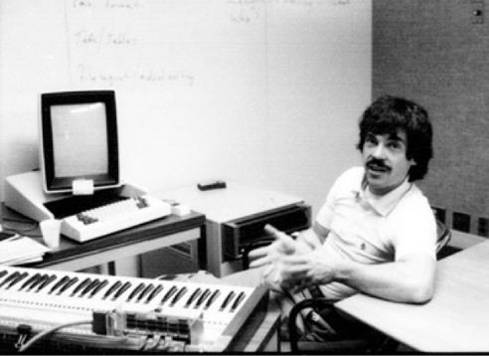
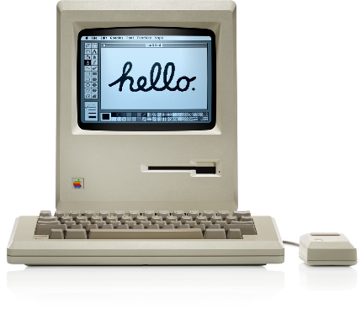
HCC
Human-Centered Computing
Douglas Engelbart
The Mother of all Demos
1968
Alan Kay
Alto / Star (Xerox Parc)
1973
Apple Macintosh
1984

Slide 5
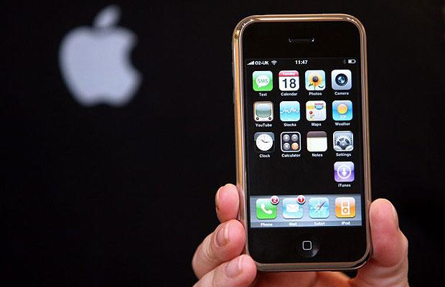
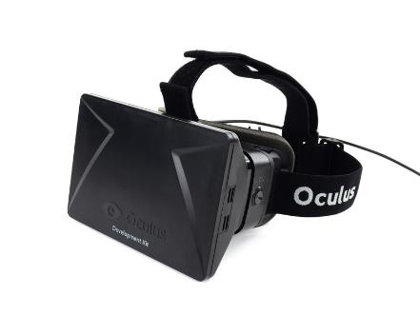
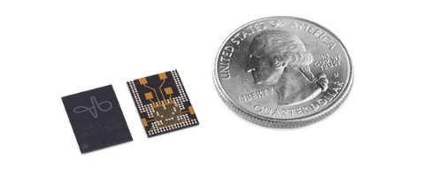
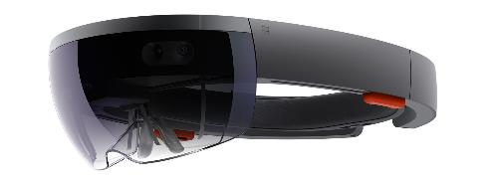

HCC
Human-Centered Computing
Apple iPhone
2007
Oculus Rift
HTC Vive
Microsoft Hololens
Google Soli (Radar Technology)

Slide 6

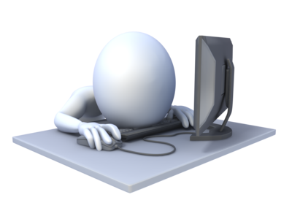


Terminology
Human-Computer Interaction
The study between people and interactive technologies
(3D) User Interfaces
Communication Medium Between User and Computer
Gesture User Interfaces
Interactive Interfaces control by Gestures

Slide 7

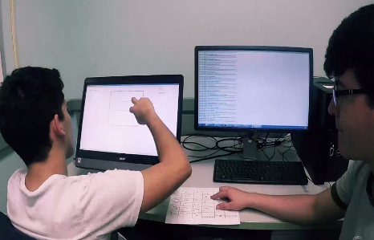
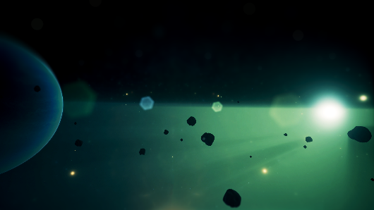
Challenges
Elicitation
• How to find a gesture set • How to reduce Legacy Bias
Recognition
• Interactive Gesture Recognition • Context-Aware • Multi-Modal Gesture Recognition
Gesture User Interfaces
• 3D Travel • Selection • Manipulation

Slide 8
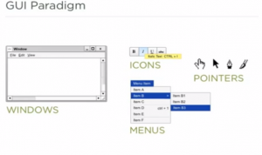
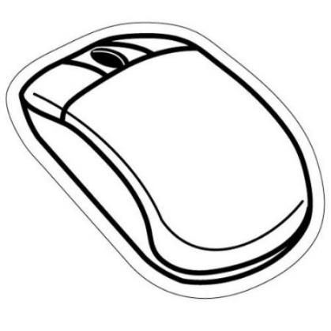

WHY?
We could just stay with Windows Icon Menu Pointer (WIMP) Paradigm
Notes:
Containers are very popular. Many induestries use cointaern to run applications.
For example Google use container to run everything that are in their clusters.
In theory,……
But in practice….
Install packages before the container start

Slide 9

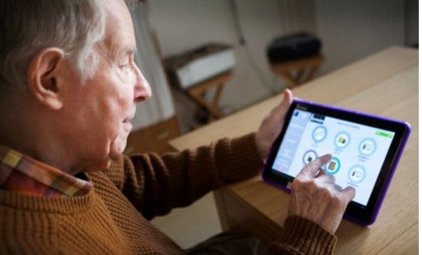
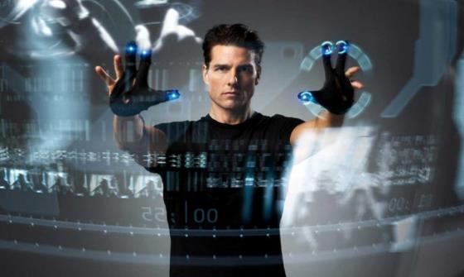
WHY?
Gesture User Interfaces are more intuitive
Notes:
Containers are very popular. Many induestries use cointaern to run applications.
For example Google use container to run everything that are in their clusters.
In theory,……
But in practice….
Install packages before the container start

Slide 10
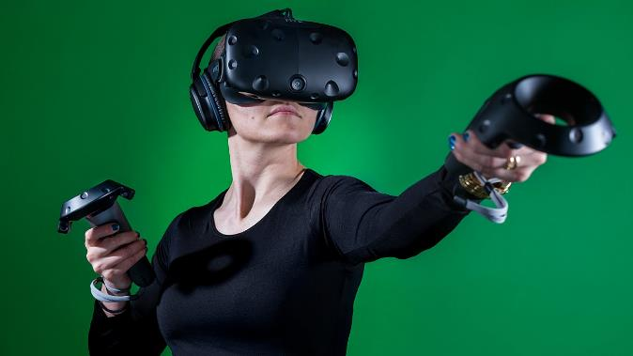
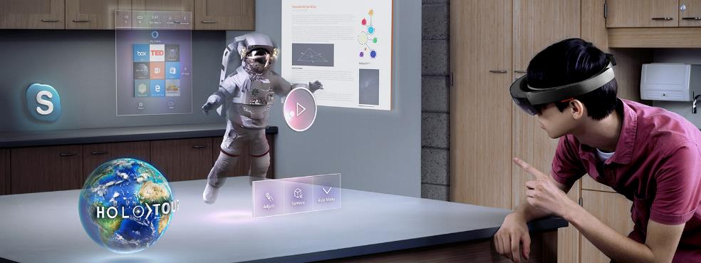
WHY?
The increase of new input modalities in order to improve 3D user interfaces, including virtual reality (VR) and augmented reality (AR).
Notes:
Containers are very popular. Many induestries use cointaern to run applications.
For example Google use container to run everything that are in their clusters.
In theory,……
But in practice….
Install packages before the container start

Slide 11
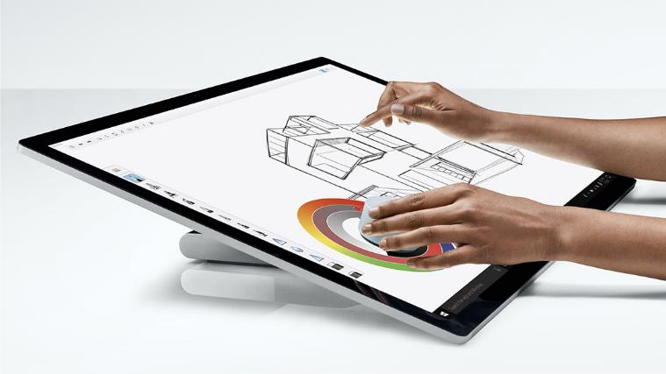
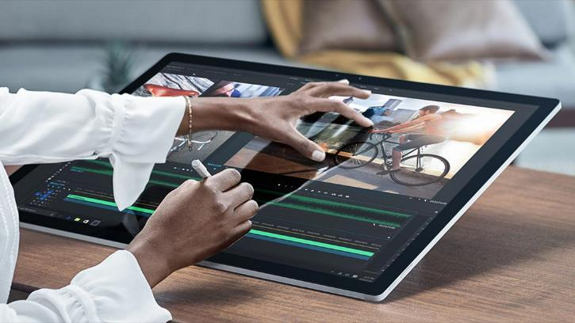
WHY?
Increase use of Multi-Touch Devices
(Bi-manual interaction still important)
Notes:
Containers are very popular. Many induestries use cointaern to run applications.
For example Google use container to run everything that are in their clusters.
In theory,……
But in practice….
Install packages before the container start

Slide 12
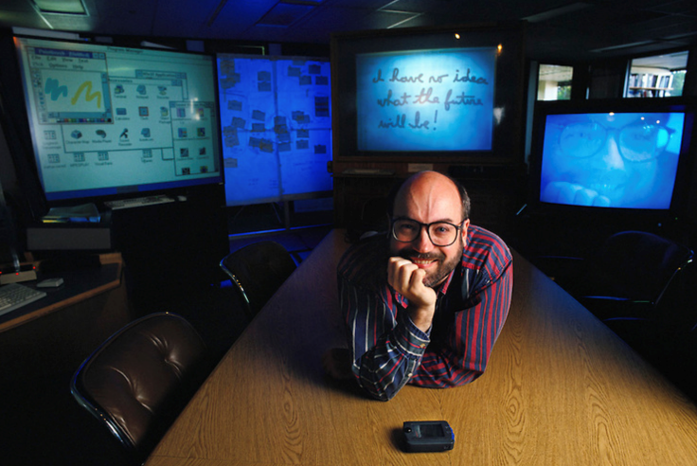
WHY?
The most profound technologies are those that disappear. They weave themselves into the fabric of everyday life until they are indistinguishable from it.
-- Mark Weiser
Notes:
Containers are very popular. Many induestries use cointaern to run applications.
For example Google use container to run everything that are in their clusters.
In theory,……
But in practice….
Install packages before the container start

Slide 13
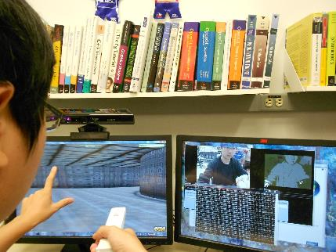

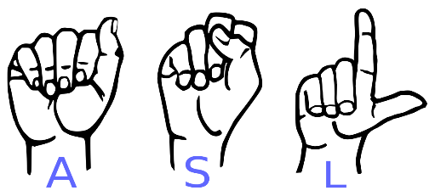
Gestures
Symbolic
• Represent a letter or sign • Rotation invariant
Non-Symbolic
• Represent an action • Rotation is not invariant in some cases
Static vs Dynamic
• Dynamic require additional movement and considerations

Slide 14
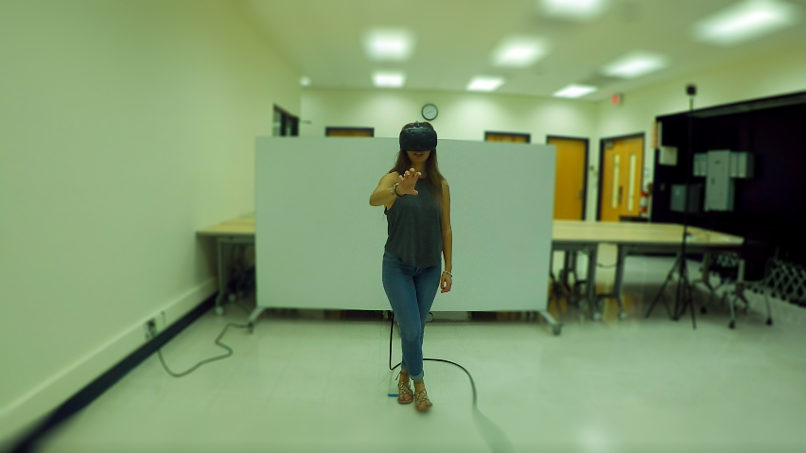
Gesture Elicitation
Gesture Elicitation is the process to discover a gesture set for a given referent set.
Let’s watch a video
Notes:
Containers are very popular. Many induestries use cointaern to run applications.
For example Google use container to run everything that are in their clusters.
In theory,……
But in practice….
Install packages before the container start

Slide 15
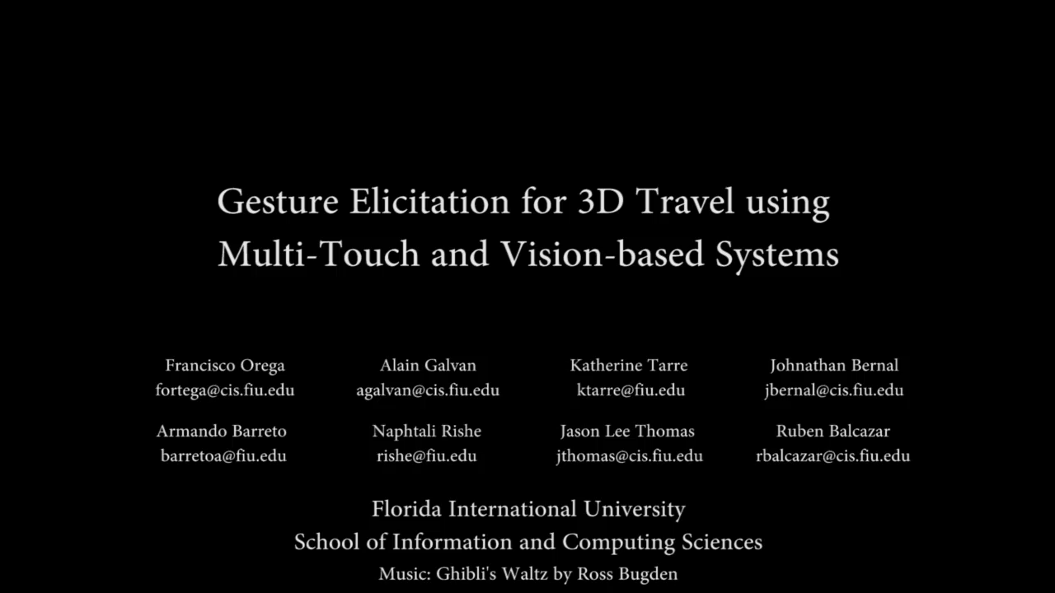

Slide 16
Data Analysis
Gesture Elicitation for 3D Travel via Multi-Touch and Mid-Air Systems for Procedurally Generated Pseudo-Universe
Ortega at al. (IEEE 3DUI 2016)
Considerations for Gesture Evaluation
• Hand(s) used, subset of fingers used, and direction of movement
Classification
• 2 independent reviewers • 3rd independent reviewer for disagreements • Agreement rates:
1 and 2 reviewer = 85.99%

Slide 17

Hypothesis
H1: The unconstrained condition will yield a greater number of one-handed gestures for all referents.
H2: The time required by participants to develop gestures will be different for multi-touch and mid-air treatments.
Notes:
Containers are very popular. Many induestries use cointaern to run applications.
For example Google use container to run everything that are in their clusters.
In theory,……
But in practice….
Install packages before the container start

Slide 18
Hypothesis
H3: Agreement rates will be higher for one-handed gestures in comparison to two-handed gestures.
H4: Legacy from the use of multi-touch will appear in the development of gestures for mid-Air interaction.
Notes:
Containers are very popular. Many induestries use cointaern to run applications.
For example Google use container to run everything that are in their clusters.
In theory,……
But in practice….
Install packages before the container start

Slide 19
Overview
Unconstrained Gestures
Two hands = 22.3%
Right hand = 75.1% (preference more pronounce in MT treatment)
Left hand = 2.6%
Preferences
MT: 83.3% prefer one-handed gestures
MA: 56.7% prefer one-handed gestures
73.3% prefer the mid-air system – more “intuitive”, “immersive”, and “natural”

Slide 20
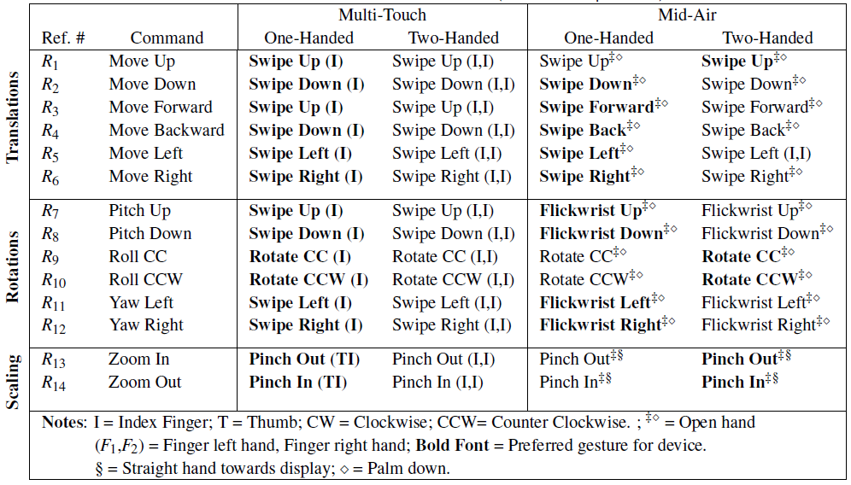
Results – Gesture Set

Slide 21
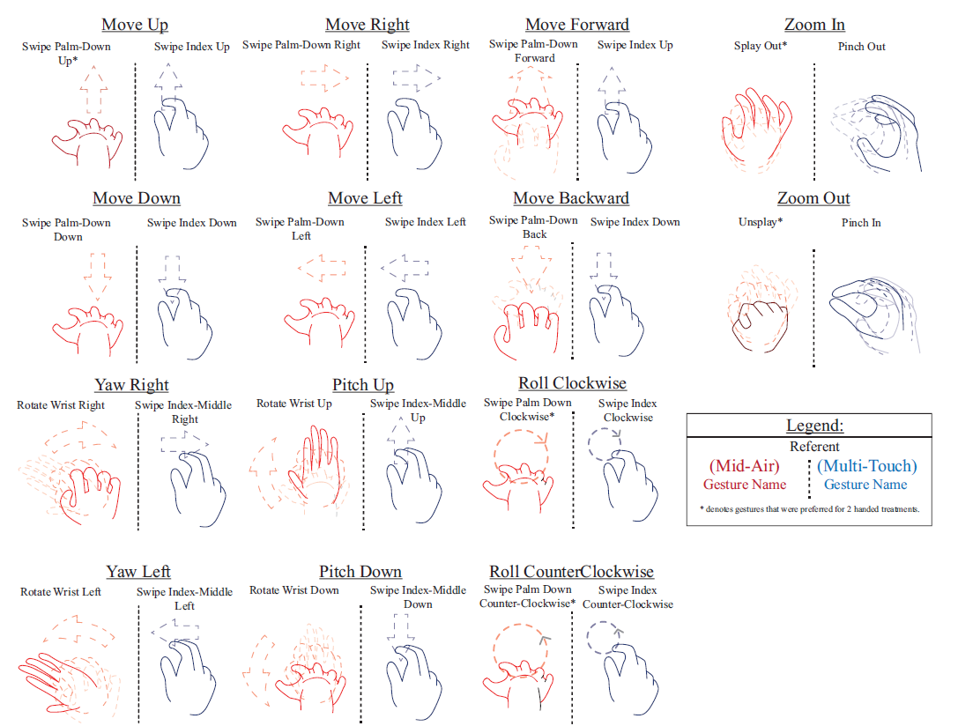
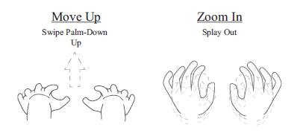
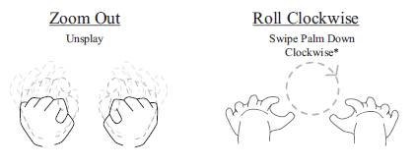
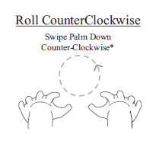
Unconstrained Gesture Set

Slide 22
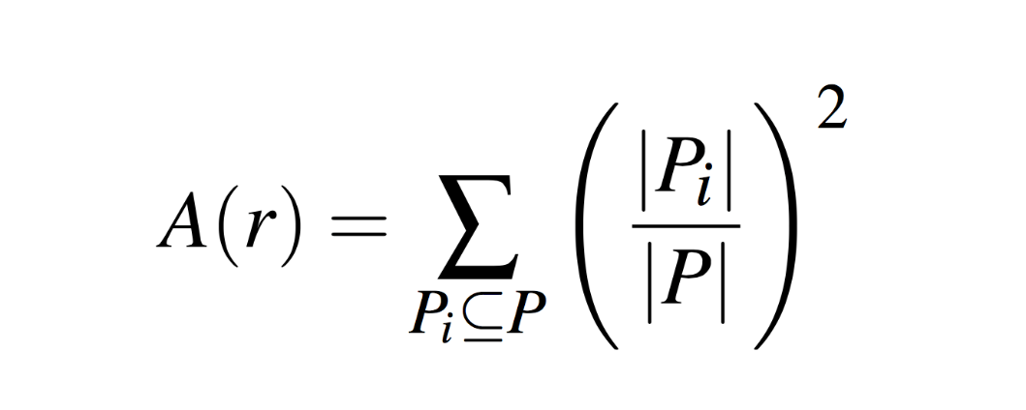
Gesture Agreement
Agreement Rate used by Wobbrock et al. (and other studies).

Slide 23
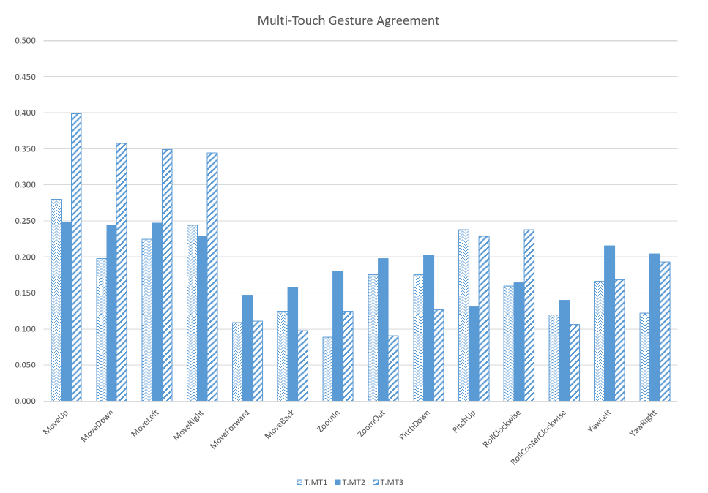
Gesture Agreement - MT

Slide 24
Gesture Agreement - MA

Slide 25
Gesture Completion Time
Expectation: MT will require less time than MA
Normality test:
MT: p-value = 0.60
MA: p-value = 0.12
Paired t-test:
t-statistic = -0.8404, df = 29
P-value = 0.40
Avg. Time: MT = 282 seconds, MA = 296 seconds

Slide 26
Limitations
Influence primary gestures because legacy bias
In particular, most users performed gestures adapted from MT during Mid-Air treatment (regardless of which one was first)
Negative influences of multiple devices
Concentrating on one device may yield better results for that specific medium.
Pseudo-space environment may have resulted in undue disorientation for the participants
For example, navigation in 3D environments is still a difficult task because the environment and user perception play an important role.
Notes:
To support this claim, various experiments have been conducted: Kozhevnikov and Dhond explored ways in which users rotate 3D images and in their findings, the authors concluded that navigation in 3D environments is influenced by the users frame of reference, e.g., egocentric vs allocentric [8], as well as by the ob- jects around them [18]; Preus et al. conducted an experiment with a focus on perception processing times. They concluded that small changes in the rotation angle can greatly influence the allocation of the self in complicated environments [32].

Slide 27
Future Work
Measure Legacy Bias and Memorability
Create multiple gestures per referent in a team setting (to counter balanced Legacy Bias)
Elicit gestures from experts
Test Expert-Drive vs User-Driven Gesture Sets
Test current environment with real-time gesture-recognition for the gestures provided in this experiment (currently working on it)
Notes:
*Develop a gesture set composed of unique gestures for each referent, followed by a sequence of requests to use the newly designed gestures in order to evaluate memorability and ease of use for said gestures.

Slide 28
Conclusion
Proposed gestures set and findings transfer to 7 DOF studies.
We found that unconstrained condition yielded a greater amount of one-handed gestures (more for MT display)
Agreement rates for one-handed and two-handed gestures were not significantly different.
Users transfer their MT experience to Mid-Air System.
Users preferred simple gestures for multi-touch, such as one- or two-finger gestures with one hand rather than complex one. (as already stated in other studies)
Our gesture-set provides a good approximation for large environments using the user-driven approach.
Notes:
2) however, we were not able to support the time difference between multi-touch and mid-air systems for the completion of all tasks.

Slide 29
Legacy Bias
Existing user knowledge about other devices/interaction/domains.
Is it bad? Depends
If needed, How do we minimize legacy bias?
Notes:
Containers are very popular. Many induestries use cointaern to run applications.
For example Google use container to run everything that are in their clusters.
In theory,……
But in practice….
Install packages before the container start

Slide 30
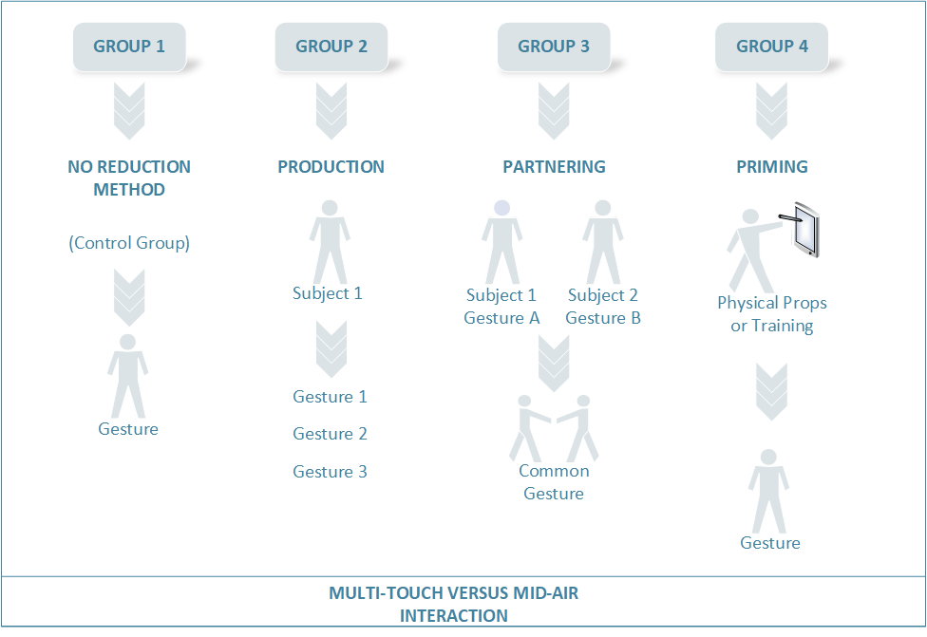
Reducing Legacy Bias

Slide 31
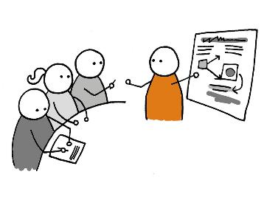
How do we measure it?
Develop GS1 with X1 (Control group)
Develop GS2 with X2 (Production group)
Develop GS3 with X3 (Partnering group)
Develop GS4 with X4 (Priming group)
Compare GS1 and GS2
Compare GS1 and GS3
Compare GS1 and GS4
Significant difference => Further work
No difference => method is ineffective
Significant difference => Further work
No difference => method is ineffective
No difference => method is ineffective
Significant difference => Further work
Notes:
Containers are very popular. Many induestries use cointaern to run applications.
For example Google use container to run everything that are in their clusters.
In theory,……
But in practice….
Install packages before the container start

Slide 32

Gesture Recognition
Why?
• Improve user interaction • Domain-specific
How ?
• Template matching • Model-based
Challenges ?
• Prediction • Error correction • Context-Aware • Multi-Modal Gesture interaction

Slide 33
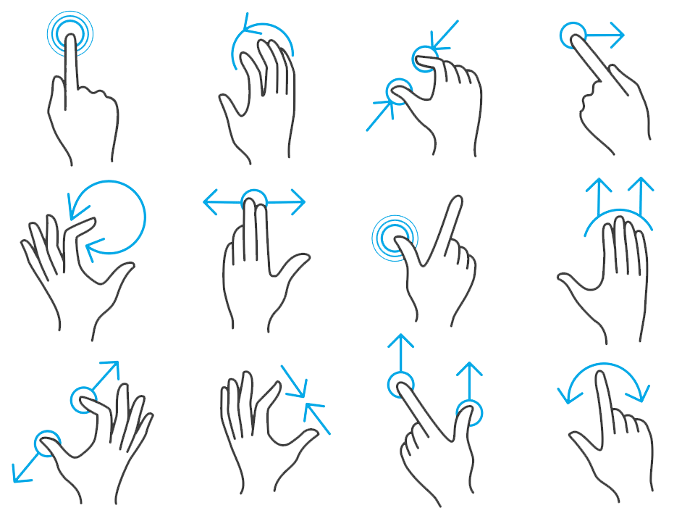
Gesture Recognition
CircGR: Interactive Multi-Touch Gesture Recognition using Circular Measurements

Slide 34
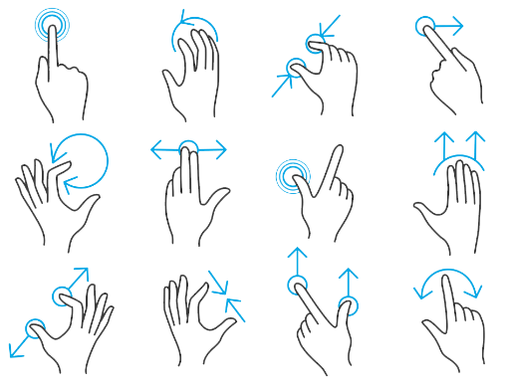
Gesture Recognition
CircGR: Interactive Multi-Touch Gesture Recognition using Circular Measurements Ruben Balcazar, Francisco R. Ortega, Katherine Tarre, Armando Barreto, Mark Weiss, and Naphtali D. Rishe (ACM ISS 2017)
Is MT a Solve Problem?
• Improve Recognition • Adaptive User Interfaces • Prediction • Context-Aware • User Intent • Multi-modal gesture recognition
Contributions
• CircGR is an interactive template-based recognition algorithm • Circular measurements focuses on non-symbolic gestures • Requires as little as 1 example per template

Slide 35
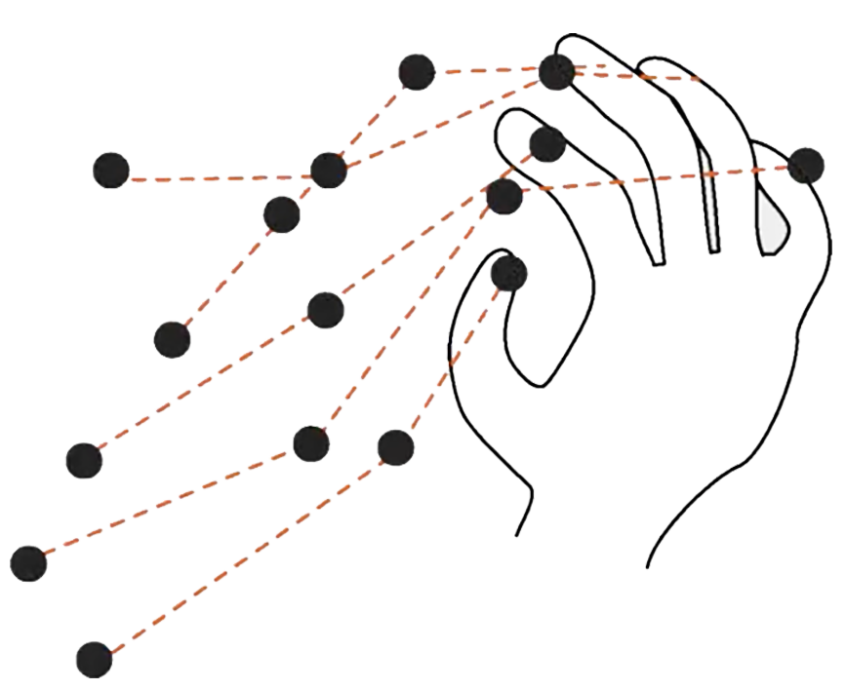
Traces and Points
CirgGR

Slide 36
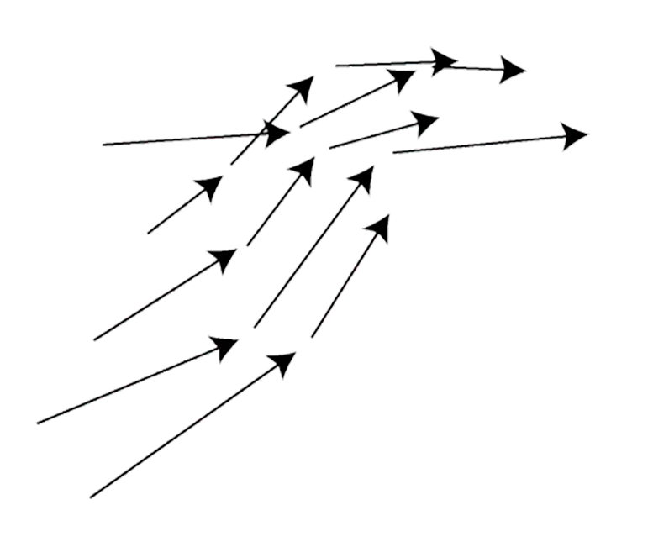
Vectors
CirgGR

Slide 37

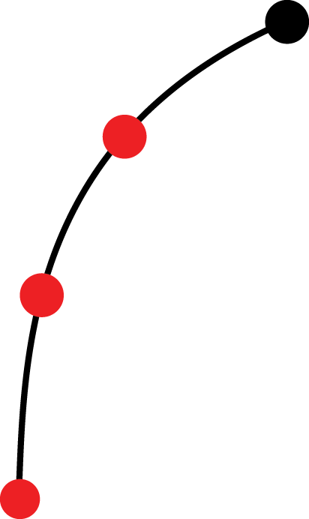
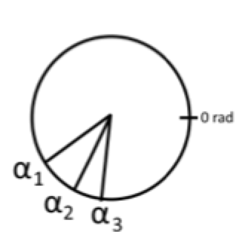
Resampling and Spatial Angle Generation
CirgGR

Slide 38
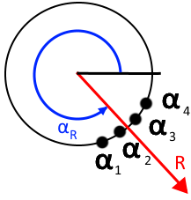
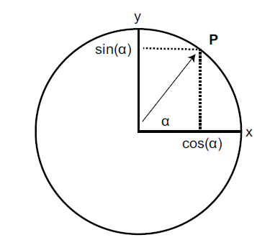
Circular Measures
Resultant Vector R
Average of a set of N angles α_{i}
R is not a unit vector
CirgGR
Notes:
Standard observation of CircGR is a polar angle to unit vector

Slide 39

Circular Distance
Circular distance d between two angles, α and β, is the length of the smallest arc between them.
CirgGR

Slide 40

Circular Distance
Circular distance d between two angles, α and β, is the length of the smallest arc between them.
CirgGR

Slide 41

Temporal Angles Generation
CirgGR
Notes:
* The total duration of the gesture, ΔG, starting at time t_{s} is wrapped around a circular interval
* A temporal angle α_{i}^{T} is calculated from the timestamp of interpolated point p

Slide 42

Labels
Each all angles generated are assigned 3 labels
Propagation
Centripetal
Clock
Position of α_{i}^{S} on a sector determine Propagation label
Directional Margin θ provides a buffer for 4 cardinal sectors (U,D,L,R)
CirgGR
Notes:
If needed, say it: For all angles ,the spatial angle α_{i}^{S} is used to generate determine labels followed by temporal angle α_{i}^{T} receiving the same labels
Centripetal labels is based on the pair of points that generate an angle

Slide 43
Early Detection
ACC=99% and MCC = 0.86 for the first window (64 points)
Contribution
CirgGR

Slide 44

Post-Hoc Evaluation Results and Running Time
Contribution
CirgGR
Notes:
CircGR v.s. $P v.s. $P-Filter
P-Filter is $P with template filtering
Offline classification of experimental data
Evaluated over:
ACC and MCC metrics
Batch Time: Time to classify all data
Per Gesture: time to classify a gesture

Slide 45

Gesture Set
Contribution
CirgGR
Notes:
Evaluated with over 12,000 gestures collected from 60 participants over a gesture set of 36 gestures

Slide 46
Classification Flow
Classification via Template Comparison
03
New input 2D traces are resampled
01
02
Angles are generated and labeled
CirgGR
Notes:
Input Gesture is classified as the template with the smallest total distance
Total distance is the sum of all circular distances between angles of the template and of the input
Spatial angles
Sorted
Compared along similar labels (those that are “U”, or “IN”, etc.)
Unpaired observations are compared to gesture resultant angle
Dominates the run time
Temporal
Compared in order generated across similar labels
Unpaired observations are penalized with a distance of π

Slide 47
Gesture Representation
A CircGR gesture consist of two sets of n angles:
Spatial Angles (S)
S = {α_{i}^{S} | i = 1..n}
Temporal Angles (T)
T = {α_{i}^{T} | i = 1..n}
Spatial angles are derived from the position (x,y) input points
while temporal angles are derived from their timestamp.
CirgGR

Slide 48


Resampling and Spatial Angle Generation
Resampling generates fixed number of interpolated points for each trace.
Spatial angle α_{i}^{S} is calculated from points p_{i} and p_{i-1}
$α_{i}^{S}=atan2(p_{i}.x −$ $p_{i −1}.x , p_{i}.y − p_{i −1}.y)$
$$α_{i}^{S}+=2π if α_{i}^{S}<0$$
CirgGR
Traces with very small or no movements are treated as anchors and don’t contribute angles.

Slide 49

Temporal Angles Generation
The total duration of the gesture, ΔG, starting at time t_{s} is wrapped around a circular interval
A temporal angle α_{i}^{T} is calculated from the timestamp of interpolated point p_{i}
CirgGR

Slide 50
Labels
Each all angles generated are assigned 3 labels
Propagation
Centripetal
Clock
Position of α_{i}^{S} on a sector determine Propagation label
Directional Margin θ provides a buffer for 4 cardinal sectors (U,D,L,R)
CirgGR
Notes:
If needed, say it: For all angles ,the spatial angle α_{i}^{S} is used to generate determine labels followed by temporal angle α_{i}^{T} receiving the same labels
Centripetal labels is based on the pair of points that generate an angle

Slide 51
Future Work
Expanding our work to 3D gesture recognition.
Improve early detection.
A future study may evaluate the degradation of accuracy when omitting sorting in CircGR (this will make CircGR linear)
All Material available in http://www.circgr.com (Code, paper, appendix, video)
Data Set available upon request following IRB protocols (and other requirements)
Visit our Demo at ISS
Thanks to NSF, ISS Reviewers, and OpenHID Lab
CirgGR

Slide 52

Experiment Results
CirgGR
Accuracy = 99% MCC = 0.95

Slide 53

Experiment Results – Cohen’s Kappa
Cohen’s Kappa statistic per window
CirgGR
Notes:
Cohen’s Kappa (κ) to test the correct identification of gestures by our algorithm through each input windows 0.4 - .75 – moderate agreement, over near perfect

Slide 54
Let’s watch a video next!
CirgGR

Slide 55


Slide 56
Outline
Why am I Here?
Why Gesture User Interfaces
Gesture Elicitation and Legacy Bias
Gesture Recognition
VR/AR for CS Education

Slide 57
VR/AR CS Education
Improve recruitment of under-represented minorities and women for Computer Science
Notes:
Containers are very popular. Many induestries use cointaern to run applications.
For example Google use container to run everything that are in their clusters.
In theory,……
But in practice….
Install packages before the container start

Slide 58
VR/AR CS
Why?
• 14-18% of CS graduates are women (national US average) • Diverse teams make a difference • Hispanics may become a majority by 2044 (Texas by 2020) in the United States.
How ?
• Seek non-CS college students (e.g., Biology) by improving self-efficacy and sense of belonging • Improve CS student learning Process
• Using VR/AR Technology with games and other tools

Slide 59

CodeVR
Notes:
Containers are very popular. Many induestries use cointaern to run applications.
For example Google use container to run everything that are in their clusters.
In theory,……
But in practice….
Install packages before the container start

Slide 60

CodeVR
Notes:
Containers are very popular. Many induestries use cointaern to run applications.
For example Google use container to run everything that are in their clusters.
In theory,……
But in practice….
Install packages before the container start

Slide 61





More…

Slide 62

CYBER + HCI

Slide 63


Contact me at
fortega@colostate.edu
nuilab.org
Thanks

